Slide 1
Matt Lewis, CIRCULAR COMMUNITIES SCOTLAND
Green Procurement
The Reuse Consortium

Slide 2
Green Procurement – Key Players
Circular Communities Scotland

Slide 3
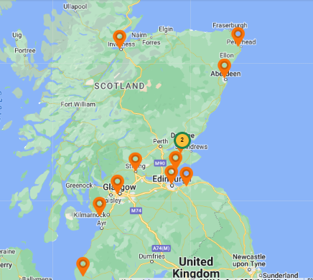
Consortium Members
9 members currently supplying
Wide range of annual turnover
Supporting a variety of social causes
Consortium Business contributes to,
and enables Social Aims

Slide 4
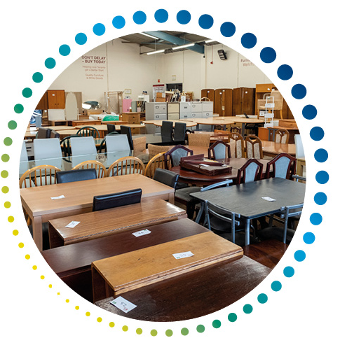
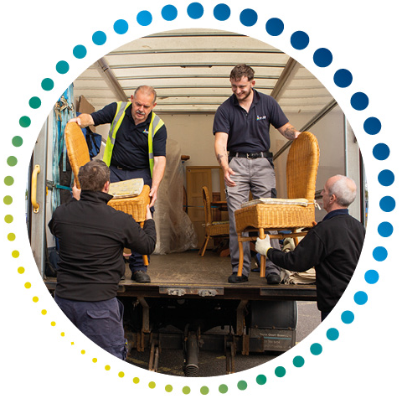
Buying from the Consortium
White Goods
Sofas and Beds
Dining and Bedroom Furniture

Slide 5
Green procurement – Why
Help the PLANET - Landfill and CO2 emissions are reduced
Helping PEOPLE - Enabling local organisations to fulfil their social mission
Help local PLACES - Employment and the local economy supported
Save POUNDS - Budgets go further

Slide 6
Consortium Workings
Coordination
Systems
Reporting
Support
New members and buyers

Slide 7
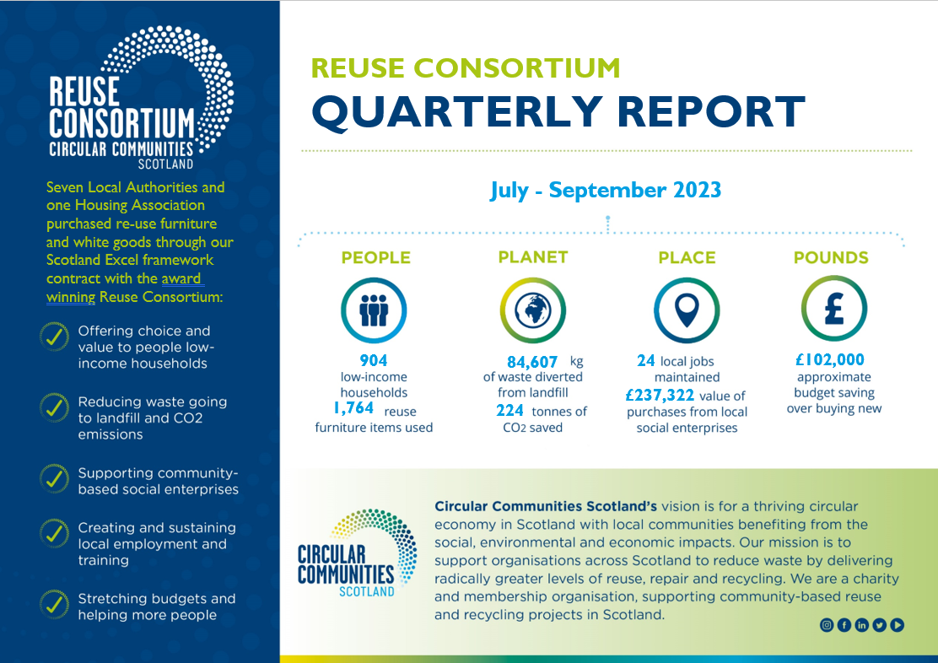

Slide 8
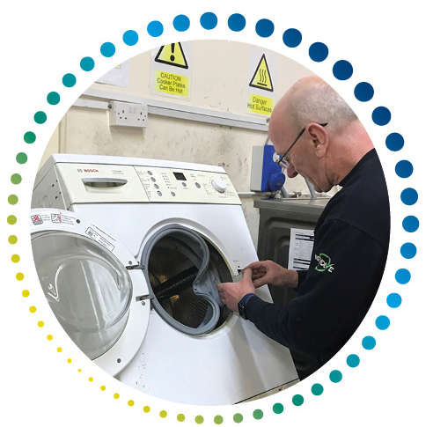
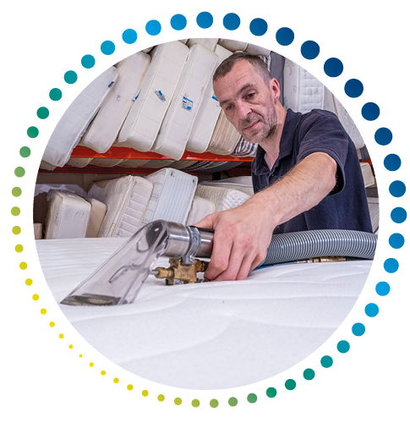
Challenges / Opportunities
Geography
Supply
Systems
Training
Community benefits
Reciprocal arrangements

Slide 9
Reuse Consortium – What People Say
Using reuse items allows us to play our part in the Council’s wider commitment to reducing our carbon footprint.
Fife Council
It’s really an ideal partnership. The Housing Association provides safe, secure social housing, and we help them turn that housing into homes.
CEO Consortium Member
Second hand doesn’t mean poor quality.
These items are built to last and often you wouldn’t even know they were second hand.
Aberdeenshire Council

Slide 10
For more information
www.reuseconsortium.org
Impact report available
Leaflet
Rhoda@circularcommunities.scot
2023 Market Builder Award

Slide 11
Rhoda Reid, CIRCULAR COMMUNITIES SCOTLAND
Thank you!

