Slide 1
Community of Practice May 2024

Slide 2
Agenda
Welcome
Understanding the wider ecosystem – Working with Co-operatives
Crisis Support
Volumes and activities
Feedback on Stirling TSI event
Business Adviser survey
JE Innovation Group
AOB

Slide 3
Support for Co-operatives
Stewart McGregor
and
Darah Zahran

Slide 4
Crisis Support
Victoria Pearce

Slide 5
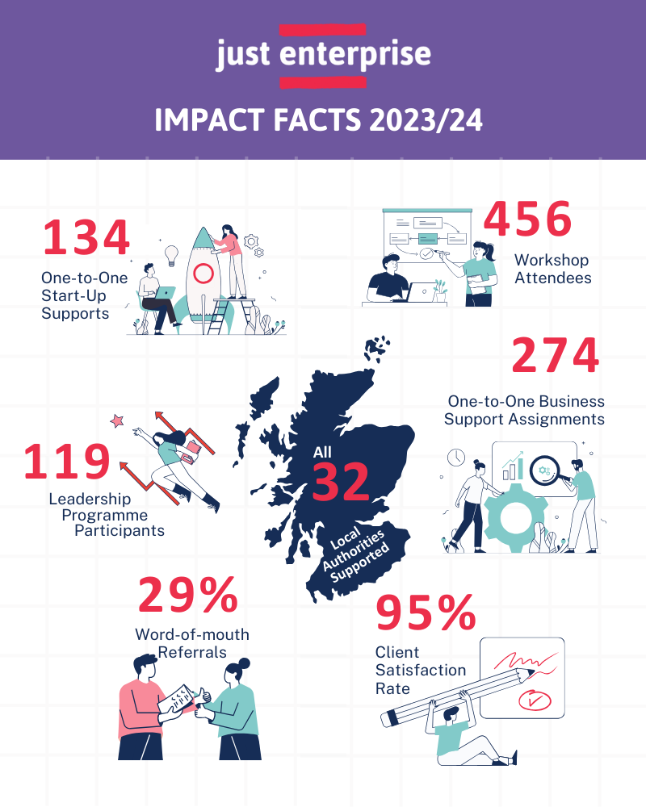

Slide 6
Volumes to Date
 | Enquiries | Recipients
Start Up 121 | 91 | 30
Start Up Ethnic Minority | 16 | 0
Business Support 121 General | 50 | 24
Business Support Impact Measurement | 24 | 19
Business Support Crisis Review | 11 | 8
Business Support Ethnic Minority | 1 | 0
Business Support Tendering | 3 | 3
Business Skills Workshops | 150 | 39
Start Up Workshops | 0 | 0
Leadership Programmes | 12 | 4
elearning | 68 | 32
Totals | 426 | 159

Slide 7
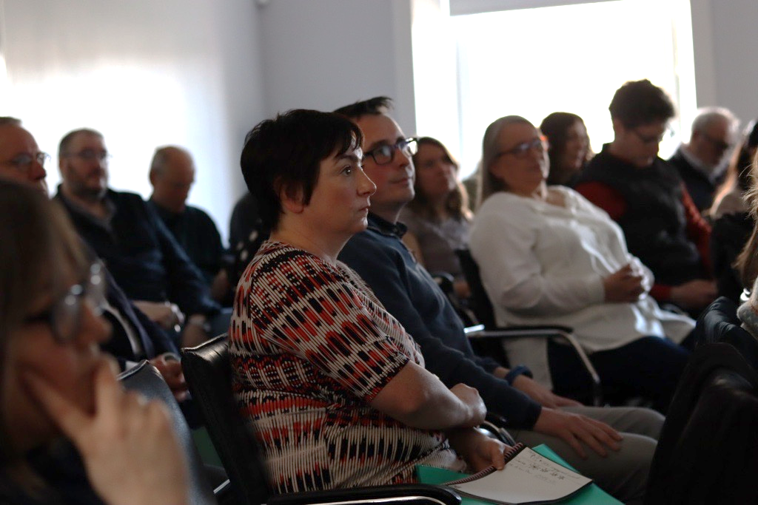
Reflections on TSI & SENs Event 26th April
National event
Build relationships and increase understanding between JE and TSIs & SENS
SES and Scottish Gov supporting the event
Stirlingshire Voluntary Enterprises from 10.00 until around 2.00pm
Numbers - around 40
12 or 13 business advisers from across the programme

Slide 8
TSI & SENs Event Feedback
Follow up local events
List of local JE contacts
List of TSI/SENs contacts and the support they can offer
Tailored comms for intermediaries
Out-of-hours learning events

Slide 9
Innovation Group
Purpose
Identify opportunities for programme development including the creation of new ideas for Just Enterprise products or services that reflect current and emerging sector need and to consider alternative models of delivery.
The objectives of the group are:
Consider emerging trends in relation to client support
Identify opportunities for new JE services
Identify opportunities for new delivery approaches
Consider and act on requests from the partnership

Slide 10
Calls to action
Please complete the advisers survey
Please complete the profile sheet
Please make contact with your local TSI/SEN

Slide 11
Next few CoP dates
25th July
26th Sept
21st Nov
23rd Jan 2025
20th March
All at 10.00 - 11.30

Slide 12
AOB

