Slide 1



Inclusive Business Models
Stewart Macgregor – Inclusive Models Specialist
stewart.macgregor@scotent.co.uk

Slide 2

Who we are & what we do?
Co-operative Development Scotland is a specialist unit within Scottish Enterprise, covering Highlands and Islands and South of Scotland.
Provides expert advice on:
Co-operatives
Employee Ownership
Knowledge, Skills & Education
Practical
Support
Market Building
Policy & Strategy
Notes:
2024/25 positioning:
We’re a co-operative development support body.
We’re not the only provider of support, but our position is key to help move towards a wellbeing economy
Worker Co-ops - Workers Co-op Federation, Co-ops UK,
Community Co-ops – DTAS and Plunkett UK
We’re trying to be both proactive with messaging and persuasive to existing businesses, to reorientate our broader economy
‘traditional’ businesses becoming IBM’s

Slide 3

Policy Environment
National Strategy for Economic Transformation (NSET)
- CWB Legislation
- Inclusive Models Review
Wellbeing Economy Governments (WEGo)
Social Enterprise Action Plan (2016 – 2026)
Scottish Government target of 500 EOBs
Notes:
These are our key policy drivers – not sure if they differ from yours…?

Slide 4
Employee Ownership
Co-operatives
Social Enterprise
Notes:
We are Inclusive Models team
‘Inclusive Models’ = ‘Plural Ownership of the economy’ – may have heard through CWB - sometimes called ‘Inclusive Ownership’.
An ‘inclusive business model’ = greater equality through;
positive societal impact - fairer profit distribution - shared ownership - allows everyone within the organisation to have a voice.
Such models are values-driven with greater democracy, accountability and collaboration at their core.
empower their employees and members - more resilient in the face of economic challenges.
Businesses built on inclusive model structures = fairer employment practices and consider positive impact
And there are 3 key models that are widely attributed to inclusive business – (click through)
Employee owned businesses tend not to be social enterprises (i.e. organisations that are committed to social objectives and to re-investing profits they make into their social mission). The majority of employee owned companies are profitable commercial businesses. Equally, they are not usually cooperatives, which can include organisations owned by customers and/or members and bound by certain operating principals or ‘rules’.

Slide 5
Co-operatives
+
=
Distinctive dividend and ownership structures
Employee Ownership
Social Enterprise
=
Re-investing profits into their social mission
Notes:
The basic distinction that start to emerge, is that Co-ops and Employee-owned businesses have distinctive dividend and ownership structures.
Social Enterprises on the other hand – more interested in re-investing profits into social mission. (Charities)

Slide 6

What is a Co-operative?
Notes:
We promote that co-ops are about the “HOW” rather than the “WHAT” – co-op’s can be almost anything, but it’s about how they do business that’s different.
We spend a lot of time dispelling myths about co-ops to corporate businesses and other public bodies
New video series helps to illustrate what we come up against a lot here in Scotland (the biggest being the Co-operative Retailer here in the UK)
<Play Video>

Slide 7
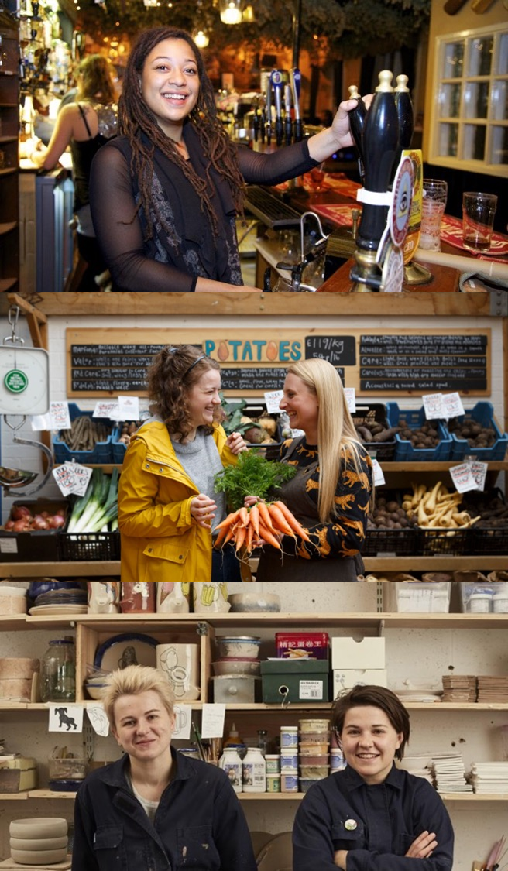
What is a co-operative?
A group of people working together to meet their common needs.
A business owned, controlled and primarily for the benefit of its members.
Notes:
Such adaptable/applicable model I feel that there's a co-operative model for all business ventures.
A co-op is a business or organisation that’s owned and controlled by its members
Membership organisation
Primary purpose is to meet the needs of those members
The members can be its customers, employees, residents or suppliers
ALL are receiving a direct benefit from being a members and they a have a say in how the co-op is run.
So Co-ops are about the HOW rather than the WHAT

Slide 8
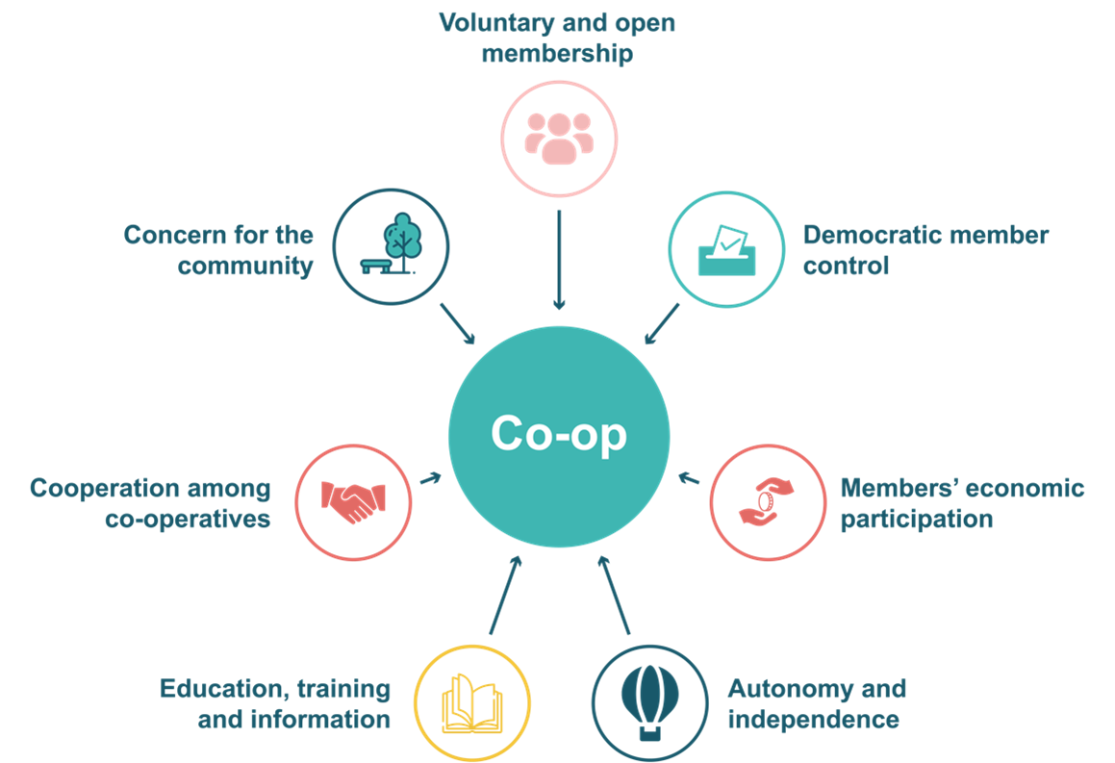
Co-operative Principles
Co-op values and principles define the way the business is run
These 7 Co-operative principles are at the heart of every co-op
Notes:
Benefits of Co-op Model:
Sharing costs, skills, resources,
knowledge and risk
Gaining new opportunities
Enjoying peer support
Gaining access to fairer, more decent work
Sharing profits
Being able to bid for larger scale tenders
Gaining access to new markets
Innovating through sharing creative ideas
Building greater brand recognition
Increasing efficiency
Increasing resilience

Slide 9
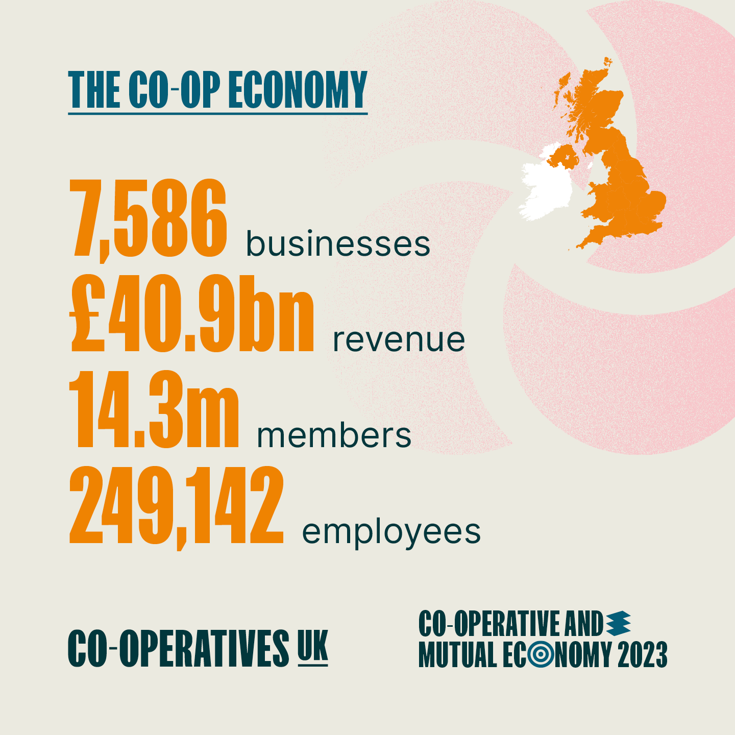
Co-operative sector in UK and Scotland
UK
7,586 independent co-op businesses employ 249,142 people and have 14.3 million members
Overall turnover of co-operative sector is £40.9 billion – an increase of 3.7% on 2022
Co-operatives are over twice as likely to survive the early years of trading when compared to other start-up businesses.
Scotland
621 co-op businesses in Scotland with a combined turnover of more than £1.8bn
(Co-operative and Mutual Economy 2023)
Notes:
- This gives a sense of the size and scale of co-ops in the UK in Scotland and contribution to economy.
Hidden business model…
So much potential to help guide businesses towards a more fairer, more democratic & resilient model
76% of new start co-ops survive their first five years compared to 42% of other types of business

Slide 10

Support for new and existing Co-operatives
Circa 2.5 days fully funded support from our specialist call off framework that could include:
Governance and legal structure review
Securing funding
Advice on membership / roles and responsibilities
Co-op “health-check” and action plan
Assess the options / Understand the benefits
Partnership approaches

Slide 11
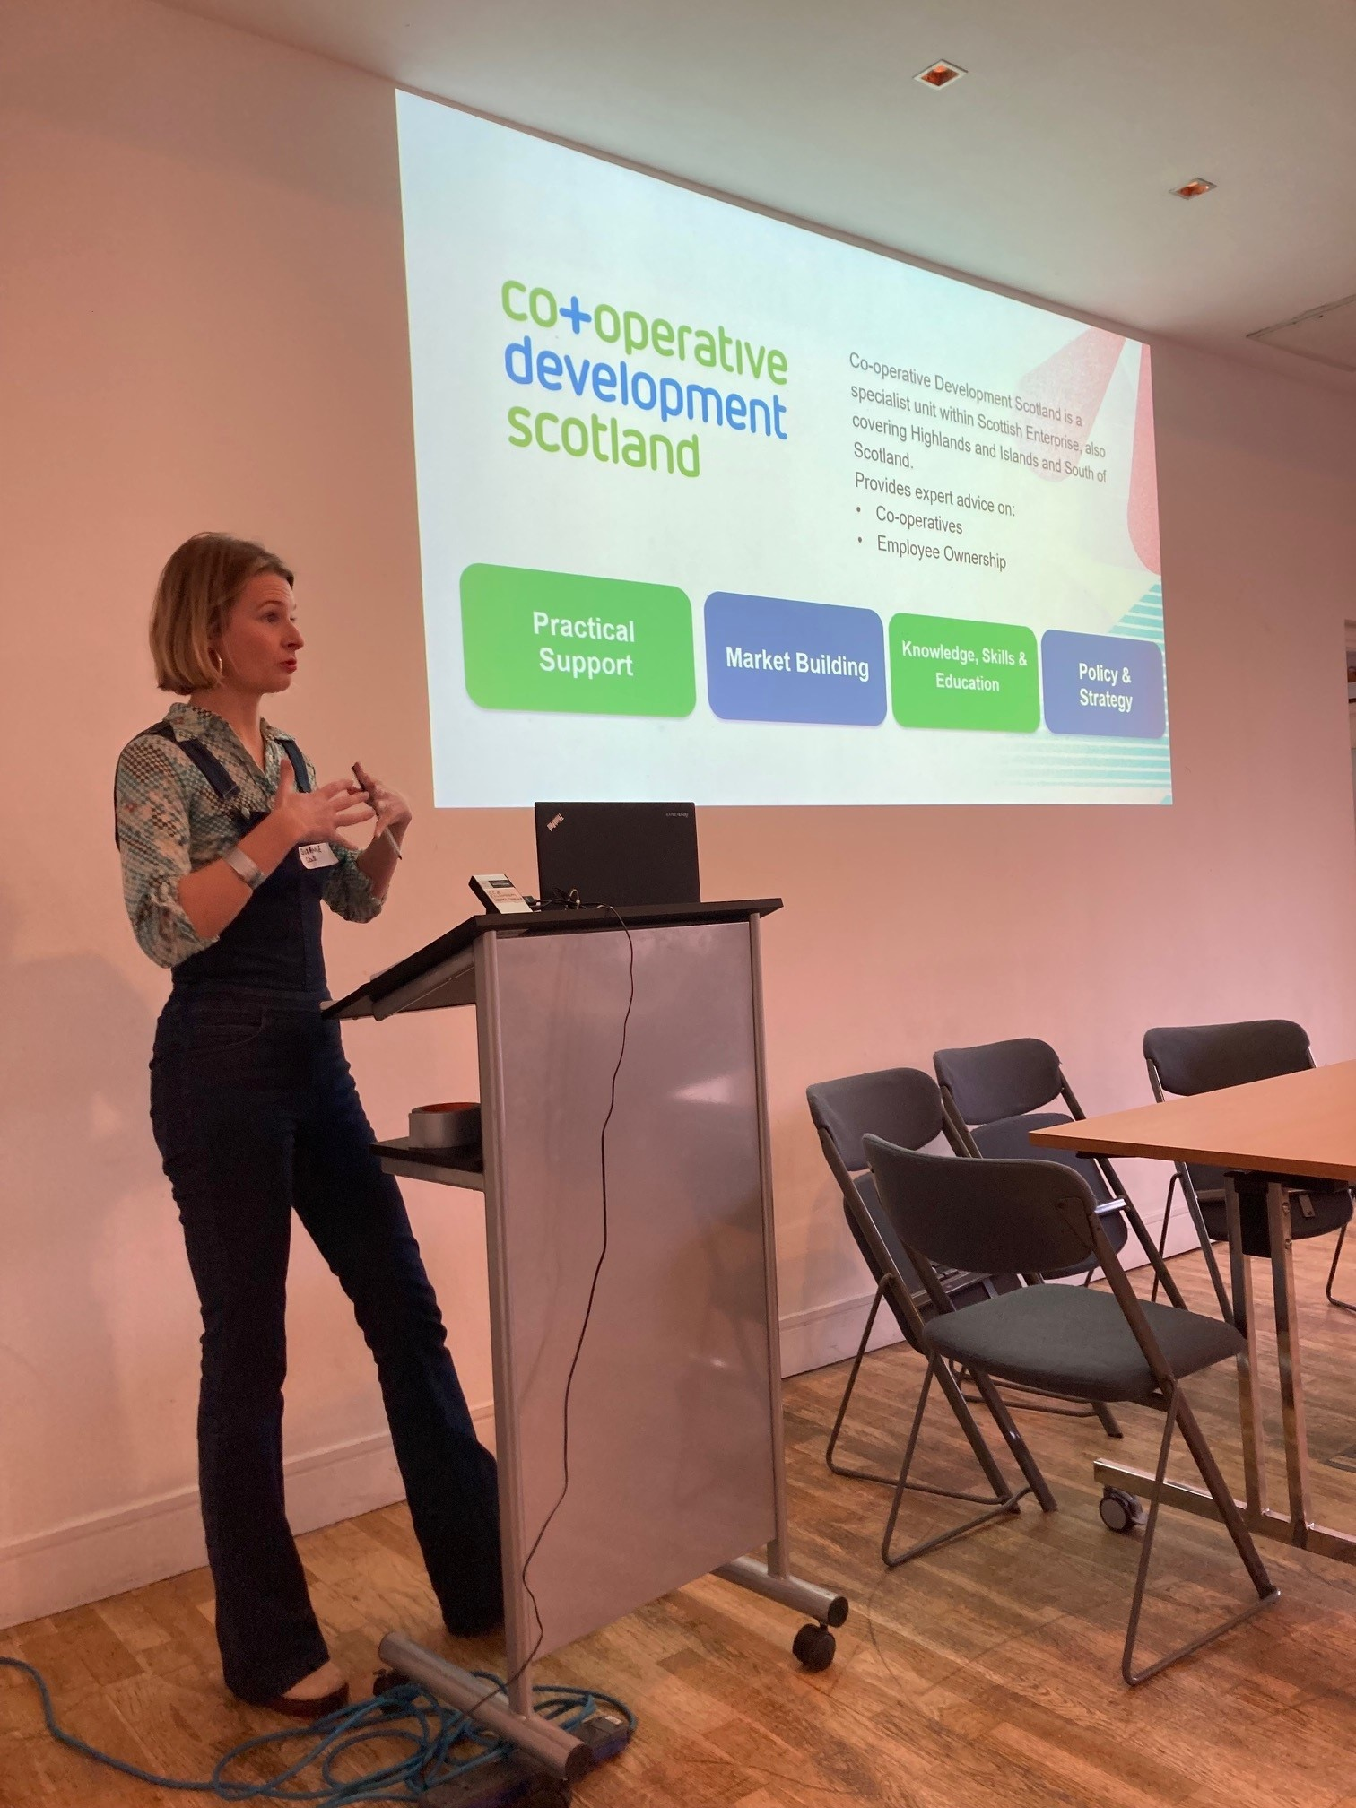
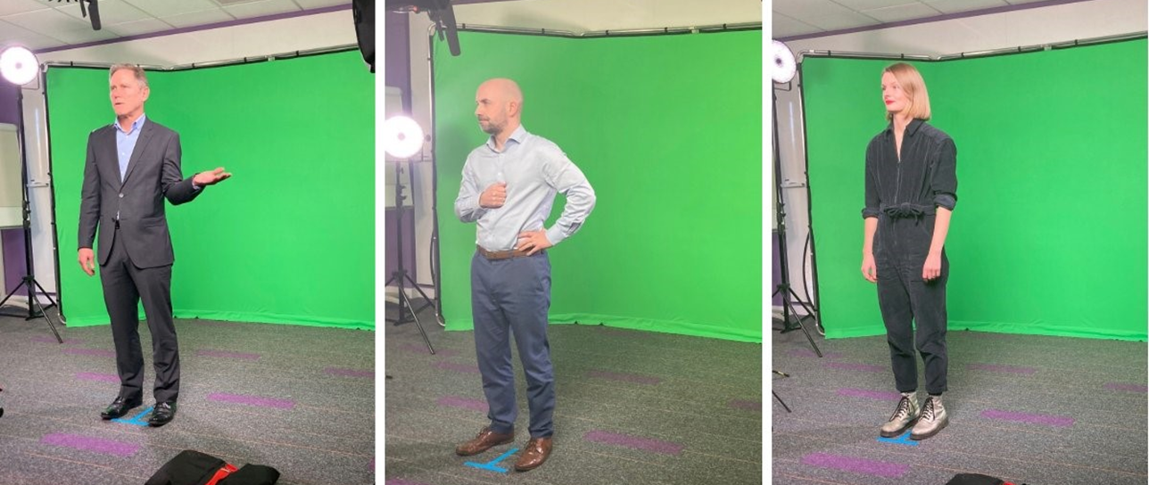
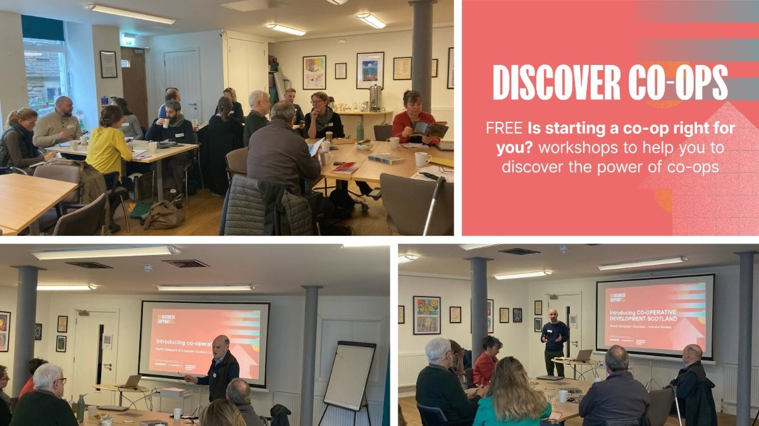
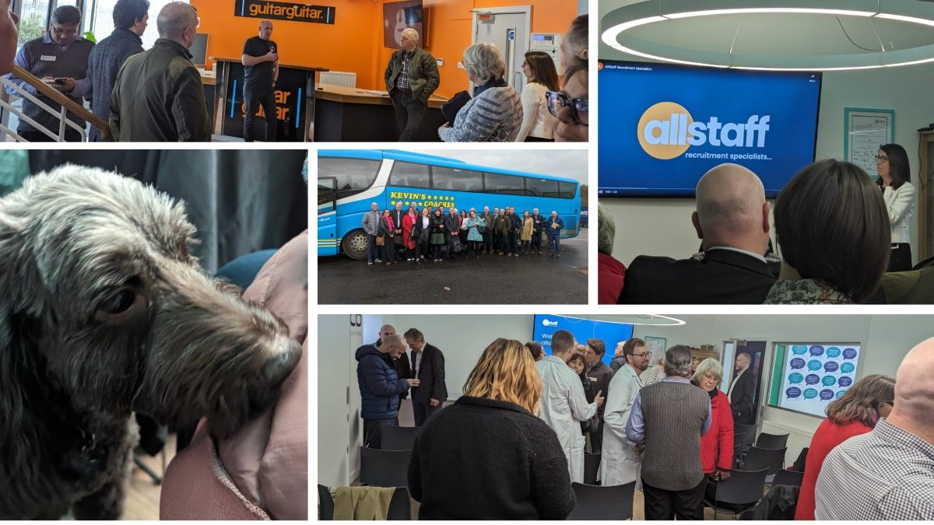
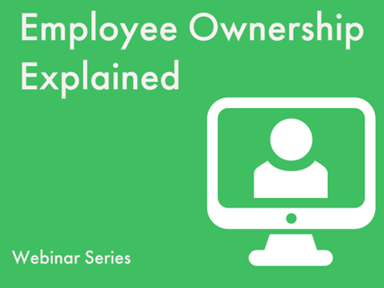
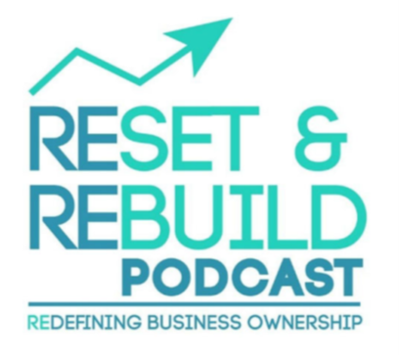
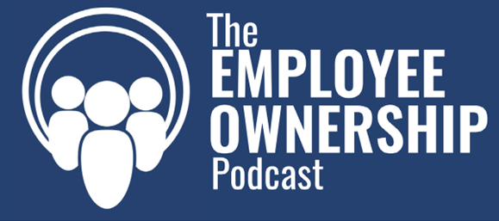

Marketing and Promotion
New video series
Partnership Events
Learning Journey
Podcasts, Webinars & Workshops
Notes:
Explain 2023/24 successes
Advanced to stage 2 (Co-op & EO specific training) + targeted LA engagement

Slide 12
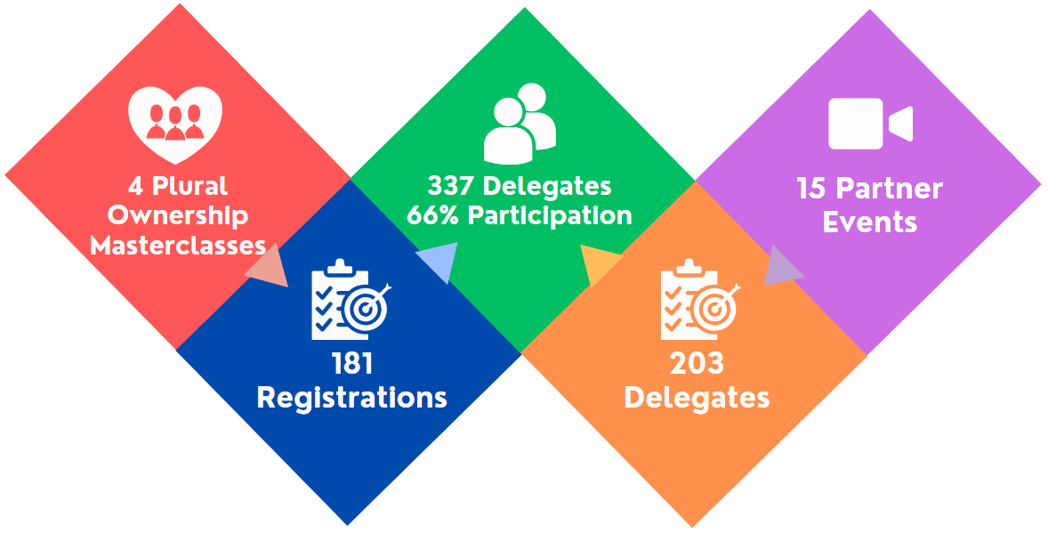
Community Wealth Building
Notes:
October - March – programme targeted at advisors, those with interest in policy / strategy around CWB
Kicked off with CDS masterclass covering all policy landscape and all co-op models and EO. 134 attendees.
Collaborated with 15 partners to run 1 hour webinars across 4 pillars – workforce, procurement, finance, land property
Run twice each – 203 delegates across programme
DTAS and CSS participated in land and property (Linda Gillespie) and Finance (Morven and Pauline)
Advanced to stage 2 (Co-op specific training) – 2 half days
Plan to run in depth EO specific training in due course
Next steps - targeted LA engagement – focussing on 5 areas HIE /SOSE /North Lan/ Fife /Aberdeenshire

Slide 13
Reflections
CDS focus on market building and awareness
Practical support related to the ‘how’ not the ‘what’
Governance is key at start-up and for existing
Need for more dedicated/specialist business support
‘No wrong door’ approach through partnerships
Particular opportunity relating to Consortium Co-ops

Slide 14
Overview of Consortium Co-operatives
Members are independent businesses / social enterprises
Number of members 2+
Democratically owned & controlled by members
Co-operative principles embedded
Consortium is legally separate
Members retain control own brand/identity
Flexible
Range of options for legal structure
A
B
F
Supplier
or Customer
Consortium
E
C
D
Notes:
In a nutshell it’s a collective of businesses with a common aim/goal
You may have been working together informally and now there is a trigger to formalise into an incorporated legal form
Often this is linked to tendering or funded projects.
We can work with 2 or more businesses but recommend at least 3.
Can be very large (e.g. tourism consortia with lots of different partners from different sectors)
Or can be very small (e.g. a small number of smaller organisations working in the same sector to bid for a contract collectively, such as in Employability).
You can adopt a wide spectrum of cooperative principles – from fairly light, to front & centre
For the legal structure, there are a range of options – Company Ltd by Guarantee is the most common; can use Comp Ltd by Shares, CIC, SCIO, or a Co-operative society

Slide 15


Case Study
Established in 2020 with 10 cross-sector partners
Deliver a multi-million-pound public sector care contract in the northeast
Market stability, improved patient outcomes and a highly trained/skilled workforce
Move away from “task & time” towards person-centred
5 Values: Co-design, Choice, Collaboration, Connected & Dignity
Notes:
After we’ve dispelled myths about the model, we then help illustrate impact through Case Studies
Granite Care Consortium is made up of 10 third sector & private sector providers with decades of experience in delivering health & social care services.
Consortium suggestion included in the tender guidance materials provided by Aberdeen City Council.
The council was looking for one operator to deliver its multi-million ‘Care at Home’ Aberdeen City Contract which combines virtually all publicly provided home care services in the city.
The Consortium was set up to create market stability, improve outcomes and build a consistent trained and skilled workforce.
Moving away from “task and time” to enable flexible support, unique for each individual, Granite Care Consortium offers a step change in how care is delivered in Aberdeen City.
Early stage but collaboration and partnership bring a new approach to care, improving outcomes, community benefits and innovation.

Slide 16

Benefits of Consortium Co-operatives
Collaboration between businesses​
Achieve scale​
Tender, innovate, export​
Collective purchasing
Flexible​
Sharing of risks and costs​

Slide 17
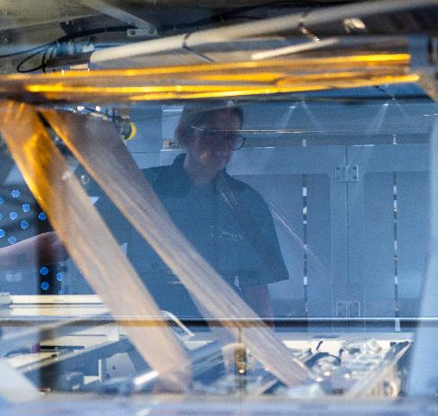
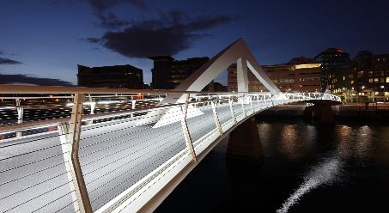
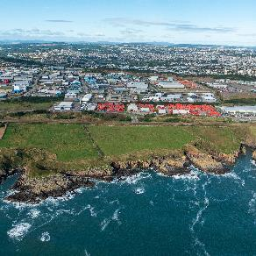

Questions & Discussion

Slide 18

What is a Consortium Co-operative?
Notes:
<Play Video>

