Slide 1
Community of Practice Oct 2024

Slide 2
Agenda
Welcome
Ecosystem Update - HIE
Q2 Update
Support
Marketing Update
AOB

Slide 3
Year 2 – April to September 2024
 |  | Current | Prior | Legend
Overall programme status |  | Green | Green | Green on or above target, amber within 15% of target, red more than 15% below target
Workstream | Start Up |  |  |  |  | Business Support |  | Leadership
 | Current status |  |  |  | Prior status | Current status | Prior status | Current status | Prior status
Overall status | Green |  |  |  | Green | Green | Green | Green | Green
Comments | Results for April to September 2024: Demand strong with enquiries, support and webinar views ahead of target 250 start up enquiries received against half year target of 213 (annual target 425) 290 webinar views against half year target of 160 (annual target 320) 114 individuals approved for 1-2-1 support against half year target of 58 (annual target 115) Additional 26 enquiries received from ethnic minority groups Programme of Start Up Learning Events commencing October 2024 |  |  |  |  | Results for April to September 2024: Demand for 1-2-1 support strong with annual target of 25 crisis support enquiries attained. 195 enquiries received for 1-2-1 business support 158 organisations approved for support against a half year target of 119 (annual target 237) 148 attendees at business skills learning events against half year target of 225 (annual target 450) Note full programme runs autumn / winter |  | Results for April to September 2024: Demand strong for Leadership Programmes with 147 Enquiries received YTD. 4 leadership programmes underway during Q2; total of 54 learners attending 27 learners booked on programmes commencing January 2025 16 individuals approved to receive 1-2-1 leadership coaching 4 organisations approved to receive support via Enterprising Boards programme

Slide 4
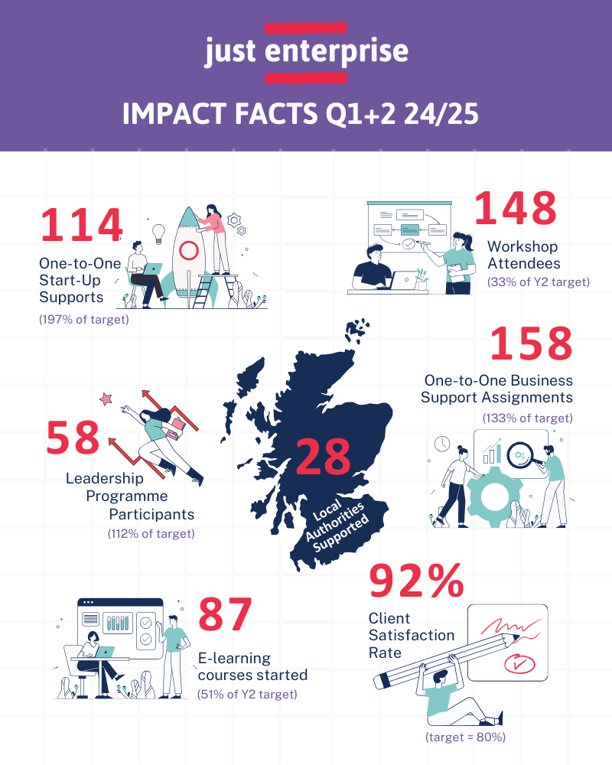

Slide 5
Enquiries

Slide 6
Referrals

Slide 7
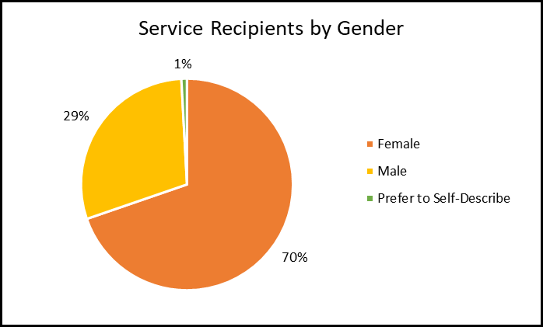
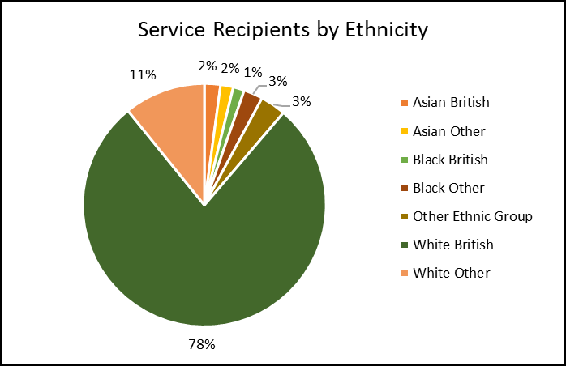
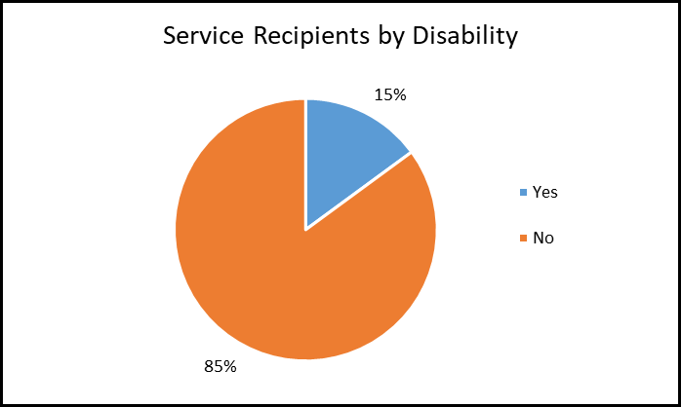
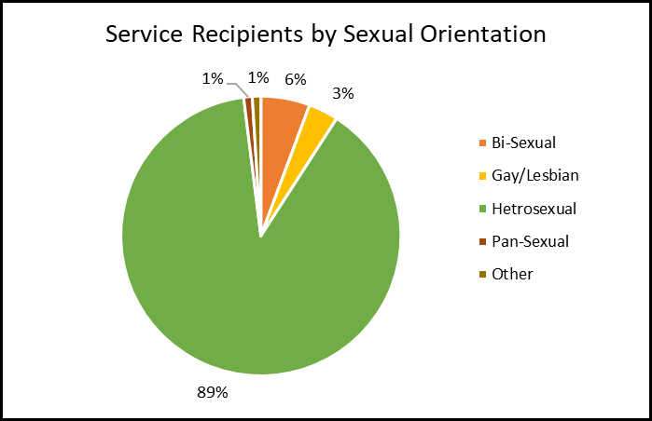
EDI profile

Slide 8
Crisis Support
Jo Slater and Karen Maclean-Yuille

Slide 9
Agenda
What is Crisis Support?
Support
Observations
Examples
Early Warning Guide

Slide 10
What is Crisis Support?
Specialist business support provided to help organisations in a crisis situation.
Requests come in through the Just Enterprise Business Support Inquiry and Crisis Support Button
Demand for crisis support through Just Enterprise remains exceptionally high with 25 applications received between April – September against a full year target of 25

Slide 11
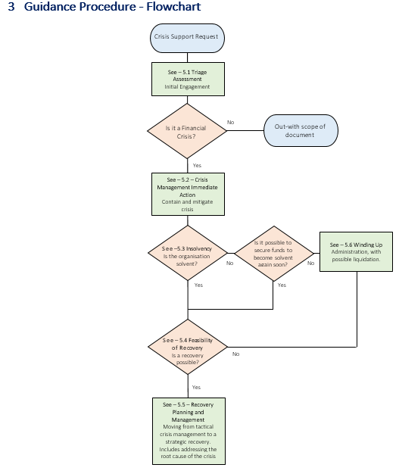
Support
When a request comes in this is directed to a specialist advisor.
A guideline document has been developed by a team of business advisors, bringing experience and skills together.
This is to ensure clients get the best support we can provide and that the support is as consistent as possible.
The guideline will be continually updated, as we learn more.
If a client makes it through crisis, it is expected that they may then require support with recovery planning.

Slide 12
Observations
The cause of crisis can vary however some of the observations have been:-
Post Covid economic climate – less availability of grant funding and public budget, reduced consumer spend
Fragile business models
Inadequate financial reporting and monitoring
Board fatigue, 1-2 people holding it together
Desire to continue to support the community, without accepting there is a serious financial problem
Lack of management and governance systems and process to secure resilience

Slide 13
Examples
Fragile business model – relied heavily on the income from one asset, poor decision making by previous board, lack of financial oversight.
Governance problems - absent Board, dominant behavior from Chair, lack of financial understanding, reluctance to accept and act on professional advice

Slide 14
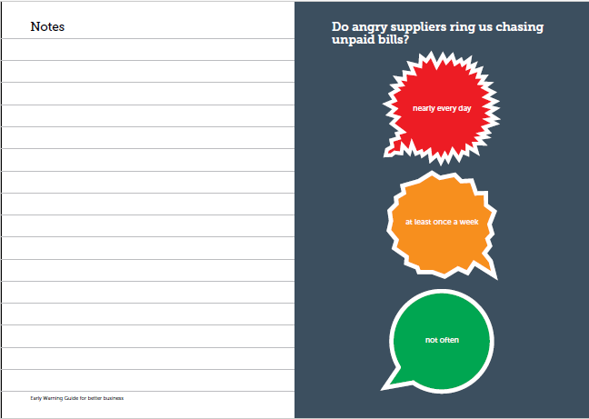
Early Warning Guide
To help minimise organisations getting to crisis, the Early Warning Guide can be used.
When Business Advisors engage in standard 1:1 support, it is recommended that a quick health check is carried out looking at key indicators such as financial position, governance and staffing. The Early Warning Guide could also be used and passed to the Board to use for on-going monitoring.

Slide 16
Marketing Update – Principle Activity Q2
Targeted campaigns focused on leadership programmes, social impact measurement, EDI, tendering and start-up workshops with good results.
Targeted campaigns have also been run to further promote one-to-one support in the Highlands and Islands areas.
Web page hubs for Tendering support and Internationalisation, plus a page for ‘Other Support’ signposting to partner agencies including SDP and Business Gateway among others.
Further development of the internal ‘Partner Zone’ on the website adding additional resources and information.
Development of an ‘Intermediaries Zone’ and specific mailing list which will launch by end October 2024.
Creation of a new Business Advisers directory which can be filtered by geographic coverage and key specialism. This will be made accessible via both the Partner and Intermediaries Zones.

Slide 17
Marketing Update – Key Stats Q2 (change vs Q1)
20,400 (+13%)
4,674 (+9%)
2,679 (+2%)
5,400 (+29%)
Total Site Users
Page Views
Total Mailing List Subscribers
Total Social Media Followers
4,700 (+42%)
3,052 (+6%)
371 (+83%)
52 (-37%)
New Site Users
Web Form Submissions
New Mailing List Subscribers
New Social Media Followers

Slide 18
Marketing Update – Priorities for Q3/4
Geographic targeting to increase demand in less represented local authorities
Greater focus on raising awareness with stakeholders and intermediaries
Communicating impact
Content production
Adding downloadable resources to the site

Slide 19
AOB

