Slide 1
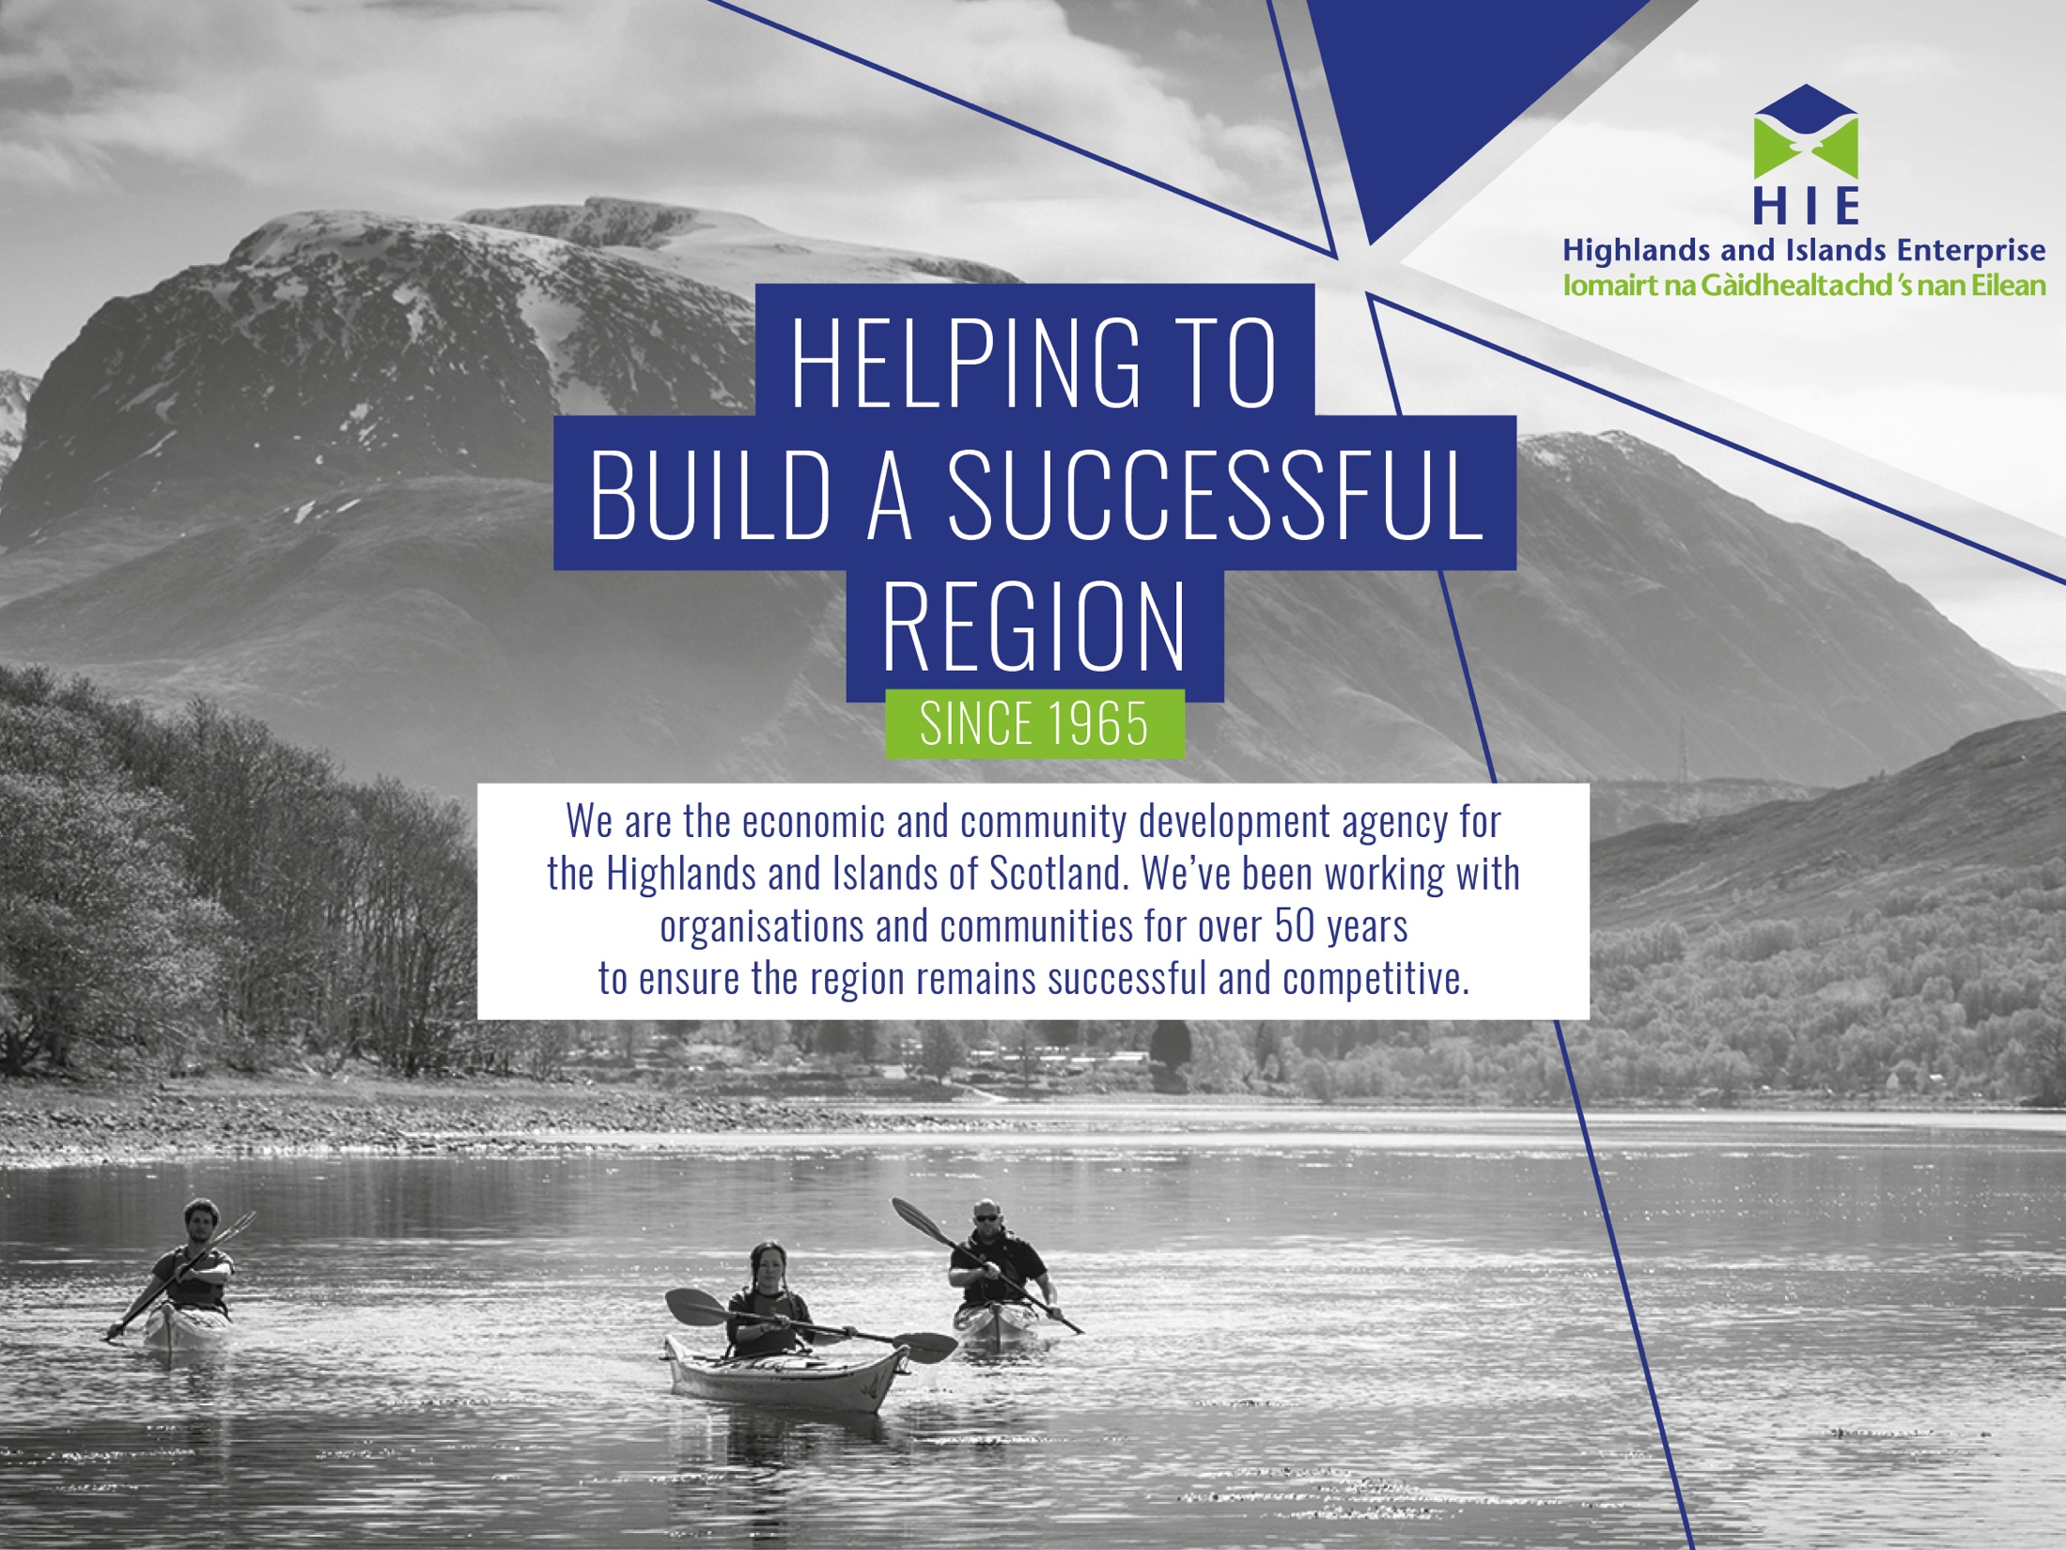

Slide 2

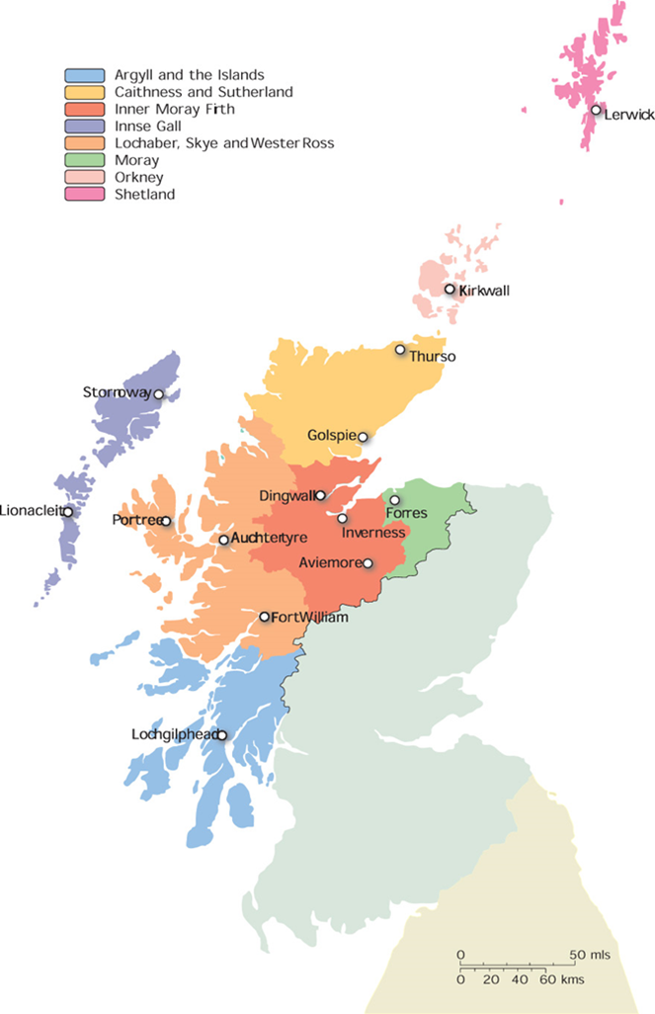
Population circa @493K of Scotland’s 5.4M
Inverness is the main town for the region but many key centres of population across the region.
High levels of self-employment and well qualified working age population.
We enable communities to contribute to the social and economic wellbeing and growth of the region.
Notes:
The Highlands and Islands stretches from Shetland in the north, to the Kintyre peninsula in the south, and from the Outer Hebrides in the west to Moray in the east. We have teams across the region helping communities and businesses to develop and grow. We help people across half of Scotland to build a stronger economy and a better future.
It accounts for just over half of Scotland’s landmass, but less than 10% of its population.
The region has a complex geography, incorporating the UK’s highest mountains, a fjord-like coastline, and around 100 inhabited islands.
Of the population of almost 470,000 in 2018, 62% live in remote areas; 23% in large settlements (13% in Inverness, the only city); and around a fifth on islands. The region has the lowest population density in the UK, and one of the lowest in Europe.
HIE considers some parts of our region as fragile and these are those where the population density is lowest: Argyll and the Islands; Lochaber, Skye and Wester Ross; Outer Hebrides; Caithness and Sutherland.
In social enterprise terms communities account for some very key assets for example in - Kintyre: (i..e. In Campbeltown) Machrihanish Airbase Community Company (land ownership – providing places for businesses to locate); Aqualibrium (sports centre); the Cinema (social and tourism amenity); Town Hall (function and business space); Kintyre Amenity Trust/Heritage Centre and Hostel

Slide 3
About us:
We work in a diverse region which extends from Shetland to Argyll, and from the Outer Hebrides to Moray, covering more than half of Scotland’s land mass. We have teams across the region helping communities and businesses to develop and grow. We help people across half of Scotland to build a stronger economy and a better future.
Our 2023-2028 vision:
The Highlands and Islands is a leading net zero region with a dynamic wellbeing economy, which benefits its growing population and makes a valued contribution to Scotland.
Our priorities:
To build and sustain a greener, fairer and more resilient region that benefits everyone through investment in:
People
Place
Planet
Prosperity
Notes:
3

Slide 4
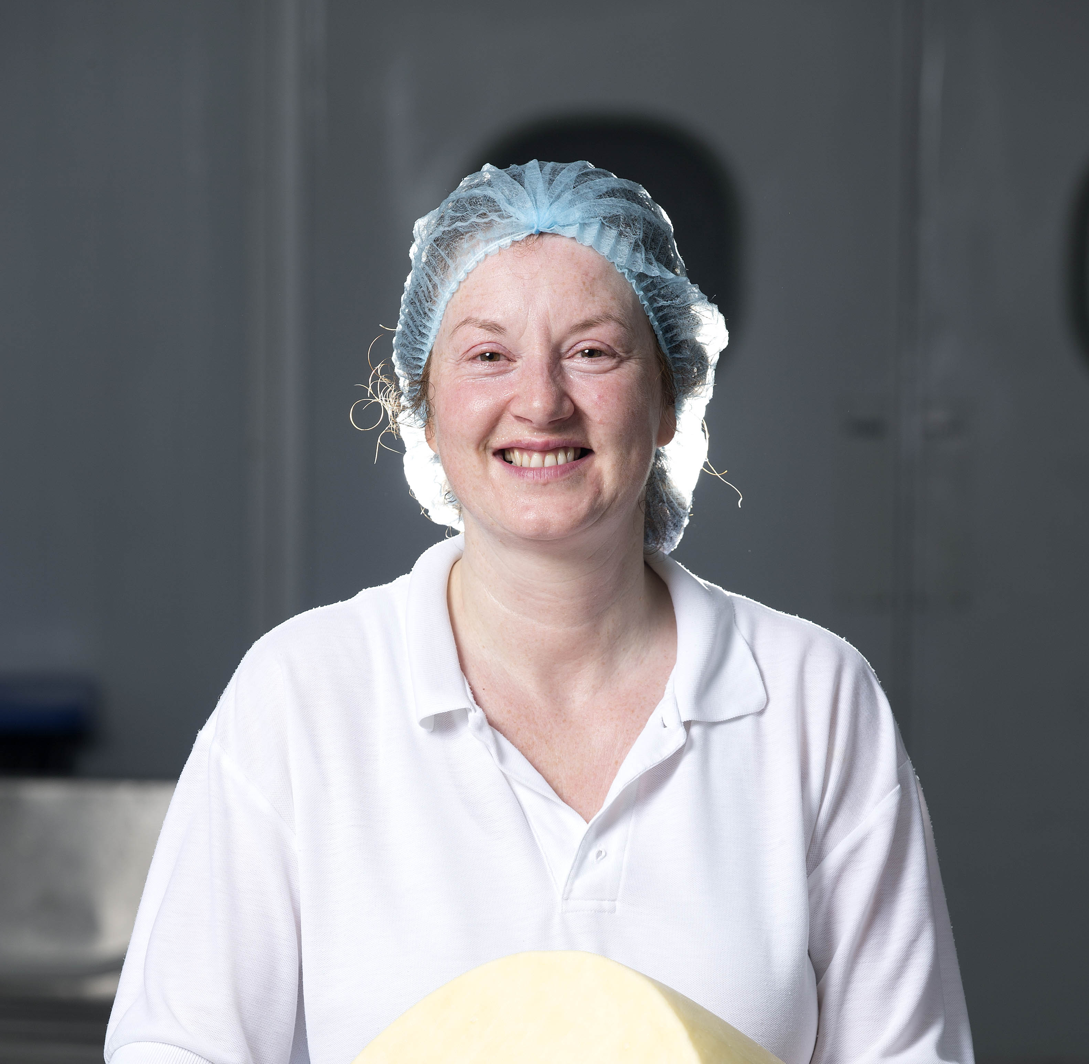
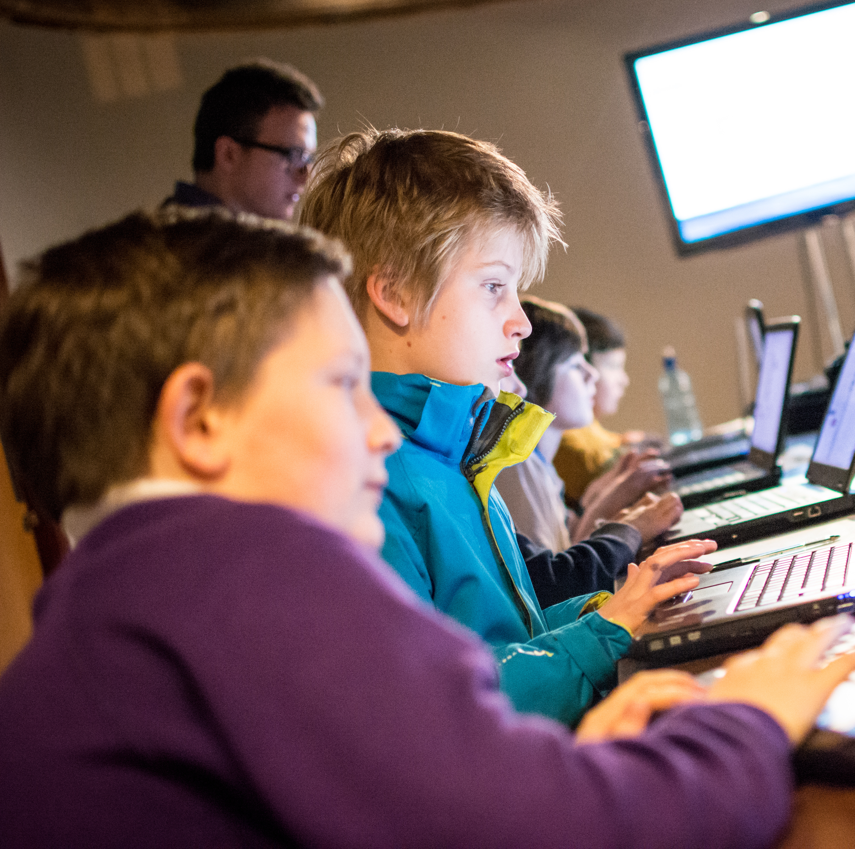
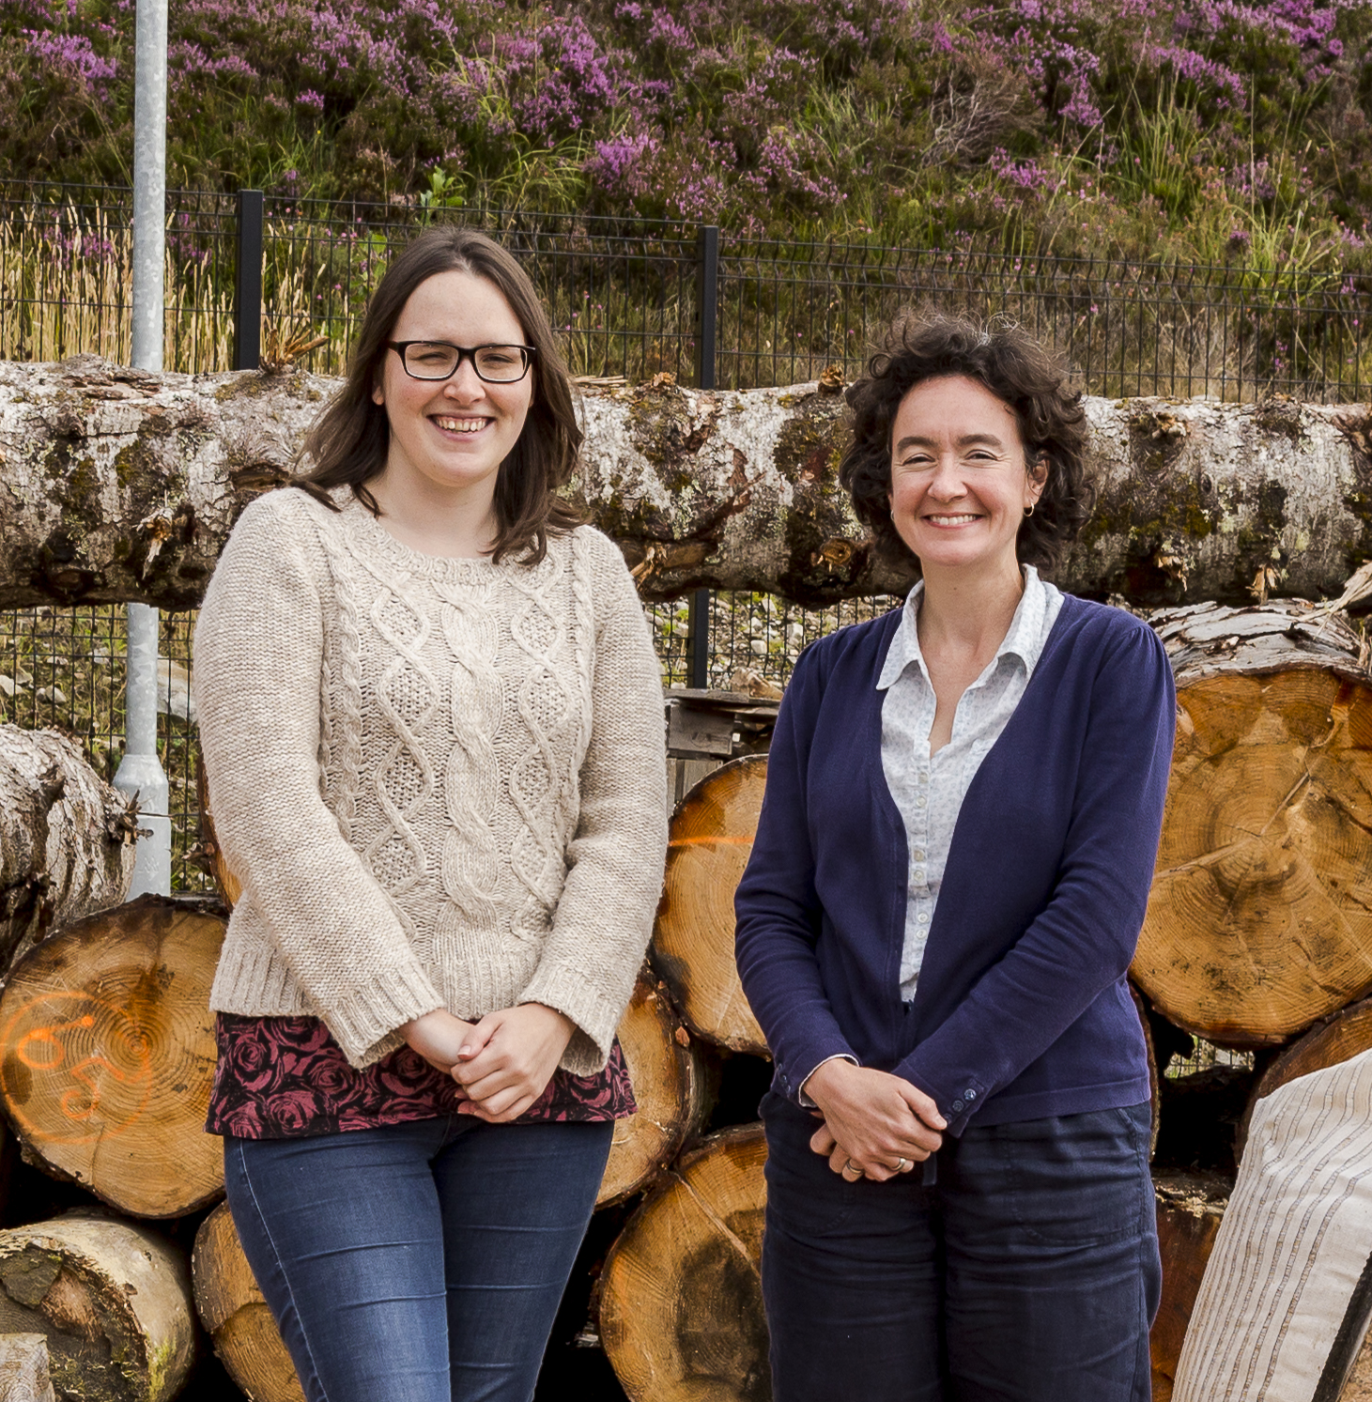
Who we work with
BUSINESSES
We offer a range of support including advice, events, funding and property to help develop and grow business.
COMMUNITIES
We support communities across our dispersed region, recognising the pivotal role that strong, resilient and capable communities play in the overall success of our economy.
SOCIAL ENTERPRISES
We have a close working relationship with around 150 social enterprises across the Highlands and Islands through our client engagement approach.
Notes:
HIE has a Regional Development activity and focus – working with public sector partners to develop infrastructure.
Translate into actions along with our cross cutting themes:
Net zero
Fair and Inclusive Growth
Regional Transformation Opportunities (RTOs) inc Offshore wind, blue economy, space

Slide 5

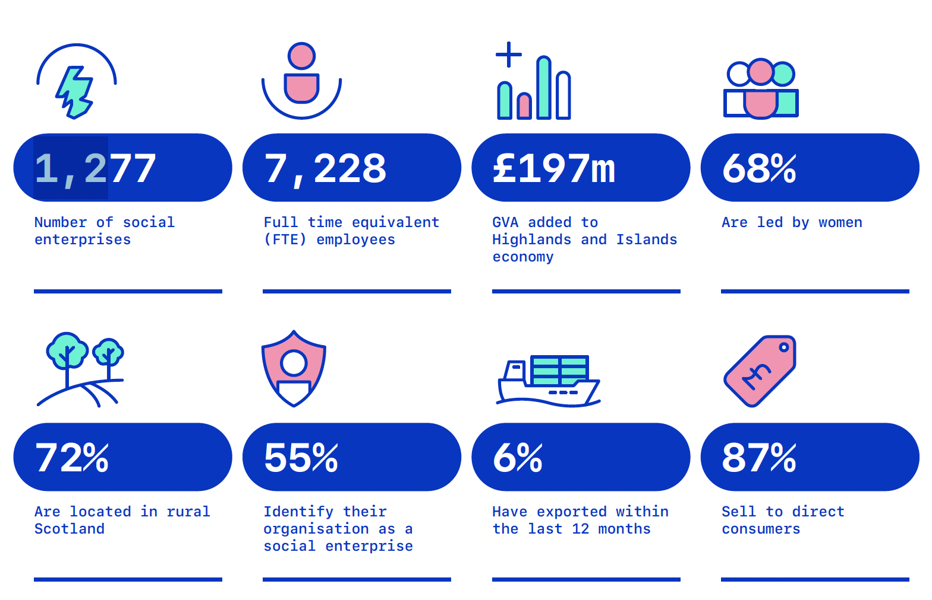
Social enterprise in Highlands and Islands (2021): key facts
Notes:
Some statistics - In terms of Social Enterprise for the Highlands and Islands:
In 2019 we had 1270 Social Enterprises recorded in the Region. In 2021 that was 1,277.
Of the 1270 Social Enterprises in the region in 2019, we have Co Ltd by Guarantee 45%; Un-incorp 23%; CIC 9.9%; SCIO 9.7%; Trusts 8.6%; Registered Societies 3.8%.
And interestingly, In a recent survey of regional businesses Among employers, 40% considered their business to be employee-owned, while 58% did not (n.b. Employee Ownership was not defined).
We currently work with circa 150 socially based entities of varying legal forms;
Of the 1270 recorded in 2019 41% were social enterprises covering a neighbourhood /community AND are led by and Accountable to People in the Area. This type of organsiation is a significant proportion of the entities we work closely with, as, by their nature they recirculate wealth back into the Place they are located in.
Other types of Inclusive ownership /socially focused organisations in the region are Employee-Owned entities such as Aquascot and Auchrannie Resort on Arran; Social Enterprise such as the Loch Ness Hub providing employment supporting tourism and its community.
What some of the following slides show are entities of these forms working in the Highlands and Islands, recirculating wealth in their place and contributing to the growth and wellbeing of their communities.

Slide 6
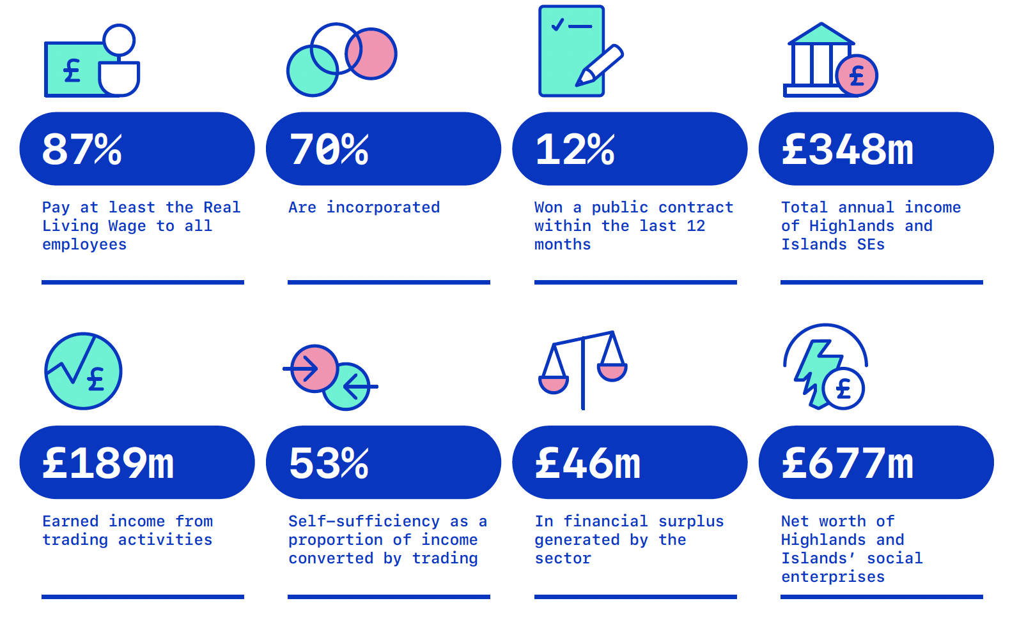
Social enterprise in Highlands and Islands (2021): key facts
Notes:
The Social Enterprise Census 2021 figures for the Highlands and Islands. 1200 across Scotland responses, plus other desk research.
The key messages coming through on review of the figures were:
There’s was a consistent rate of growth in the number of social enterprises in both the Highlands and Islands and South of Scotland regions over the previous four years.
The number of people employed in social enterprise in these areas had increased slightly to around 7,228.
Social enterprise sector for the Highlands and Islands, generated £189m in annual income (down on previous due to lockdown) and was valued at a net worth of £677m.

Slide 7
How does HIE support social and community enterprise activity?
Client Engagement / one-off interventions;
Innovation in social enterprise development;
Range of products and services, e.g. specialist advice, graduate placements;
Board development and capacity building;
Working with partners - SEA: Leadership and Learning programmes, TSIs, LaunchMe, Interface;
Cultural and Gaelic development;
Investment in people resource, e.g. Delivery Resource;
Support for Communities Framework – practical support;
Succession planning (Employee Ownership/Co-ops/ Private purchase);
Funding / networks / sign-posting. i.e. Asset purchase
Notes:
As explained our approach is 3 fold - HIE invests in building community capacity, empowers communities to acquire and manage assets and enables sustainable growth in the social economy.
These supports are developed to recognise and address some of the distinctive challenges and opportunities of our region.
How do we do this? Through Leadership, Co-ownership (partnership) or Brokering (facilitation)

Slide 8
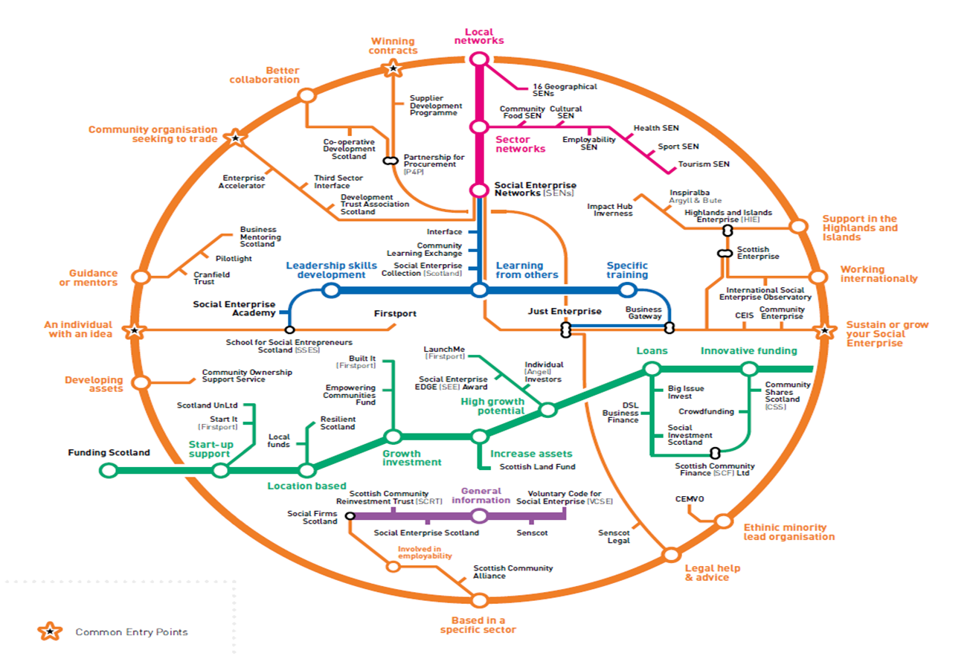
Scottish Social Enterprise EcoSystem
Notes:
To support our businesses we also work with the social enterprise ecosystem established to support social entities providing; sector networks, leadership and skills development funding and business information.

Slide 9
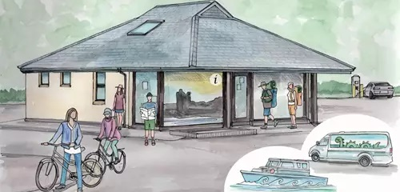
Community wealth building forms a key element – supporting inclusive growth and equality and aims to retain and build wealth within a place, for the community.
Communities are empowered to be active participants/partners in Community Wealth Building
As a result, our region has high levels of community asset ownership, community participation and social enterprise development
Our approach includes community resilience and capacity, enabling research, access to investment, leadership, innovation, volunteer development and impact measurement to help communities tell their story.
Place Based Development: https://www.hie.co.uk/remarkablecommunities

Slide 10
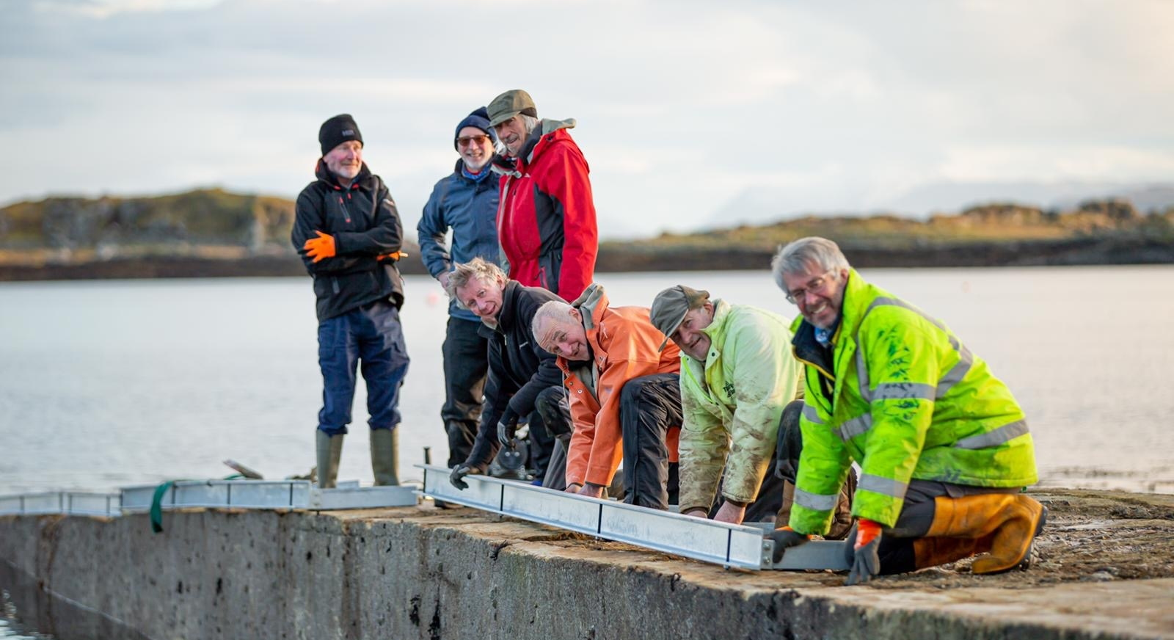
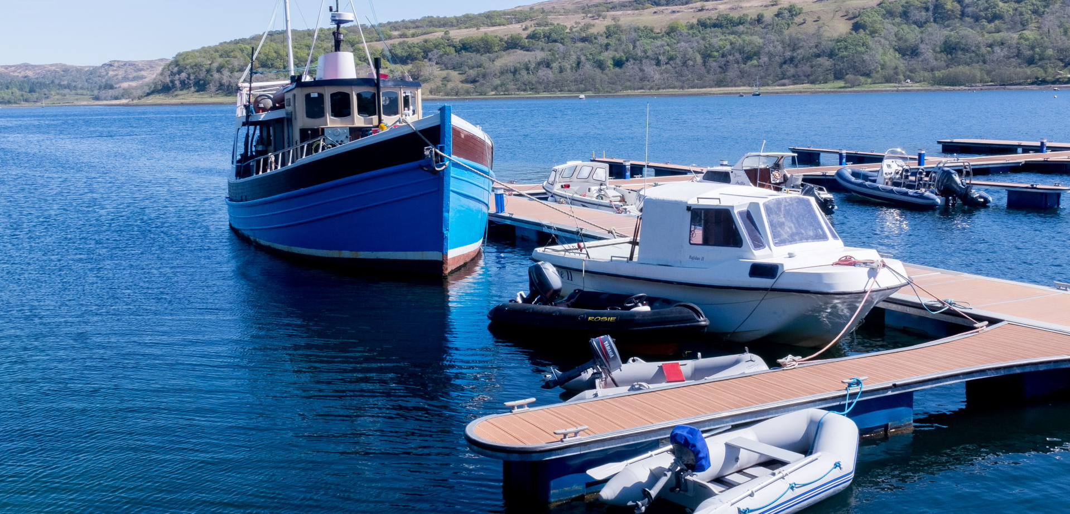
Place-based approach to development
Place has always been at the heart of our strategic direction
Inextricable link between economic and community development in the Highlands and Islands
Long history of our place-based approach, with public sector, communities, businesses and the education sector
Combining their knowledge, resources, skills and assets to make a difference
Notes:
Resilience and Capacity – advice, support and funding to support social start up and recovery in:
Governance
Leadership
Specialist advice
Innovation
Community Assets
Scottish Land Fund
Use of Gaelic
Culture and Heritage
Woodland Crofts
Community Wealth Building
Net Zero
Fair Work
Decarbonisation plans
Green jobs potential
Local food production
Shared ownership models with wind farms
Opps to adopt low carbon land uses
RIPEET
Benefits from heat resources

Slide 11
Find out more about how we work with communities at www.hie.co.uk/communitydevelopment
See HIE’s business and community case studies
Find out about #GoPlaces
www.hie.co.uk/goplaces
Find out how we are supporting net zero transition at www.hie.co.uk/lowcarbon
And follow us on social media: Twitter : Facebook : Linkedin : Instagram

